Slide 1
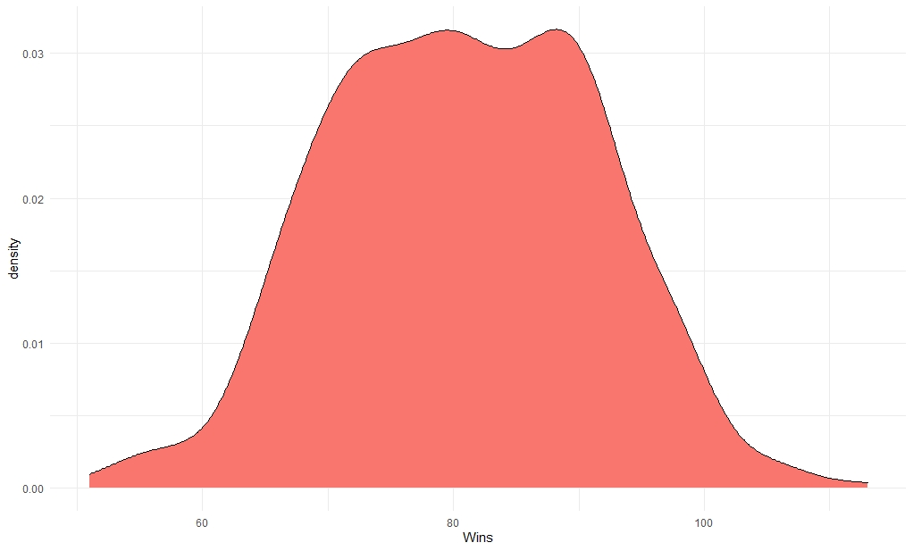
Major League Baseball Dataset Michael Jagdharry and Nicholas Weidner
Data Gathered from: www.baseball-reference.com
2004-2019 seasons for all 30 teams
N = 480
P = 43
Response Variable: Wins per season
Min: 51 Wins Max: 113 Wins Mean: 80.89 Wins
Includes Hitting and Fielding statistics such as: Batting Average, fielding percentage, runs, home runs and errors.
Wins calculated from Wins Above Average

Slide 2
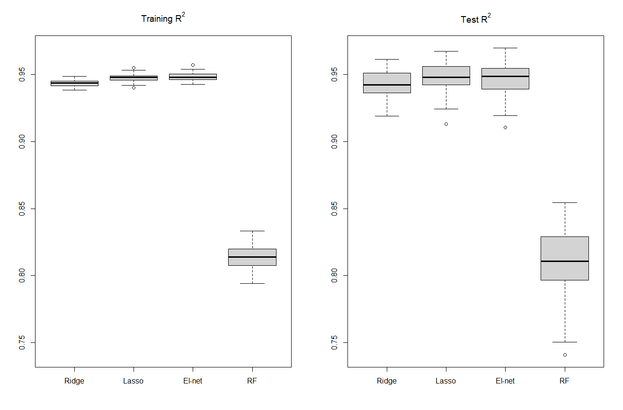
Notes:
Each of the regularization methods perform very well, each around the neighborhood of about .93. The random forest performed poorly compared to these regularization methods. Random forests require many observations per predictor to perform well, especially since it's a nonparametric model. That we only have 480 observations and 43 variables could explain the underperformance.
Suppose the true relationship between the predictors and the response is a smooth function in R^{p}. We know that the regularization methods produce a smooth p-dimensional prediction function, as they are really extensions of the ordinary least squares regression. So if the data comes from a smooth p-dimensional surface, then such methods should fit the data well. In contrast, the random forest, which is a p-dimensional step function, and therefore is not smooth, will introduce greater prediction error. The p=1 case is illustrated below.

Slide 3
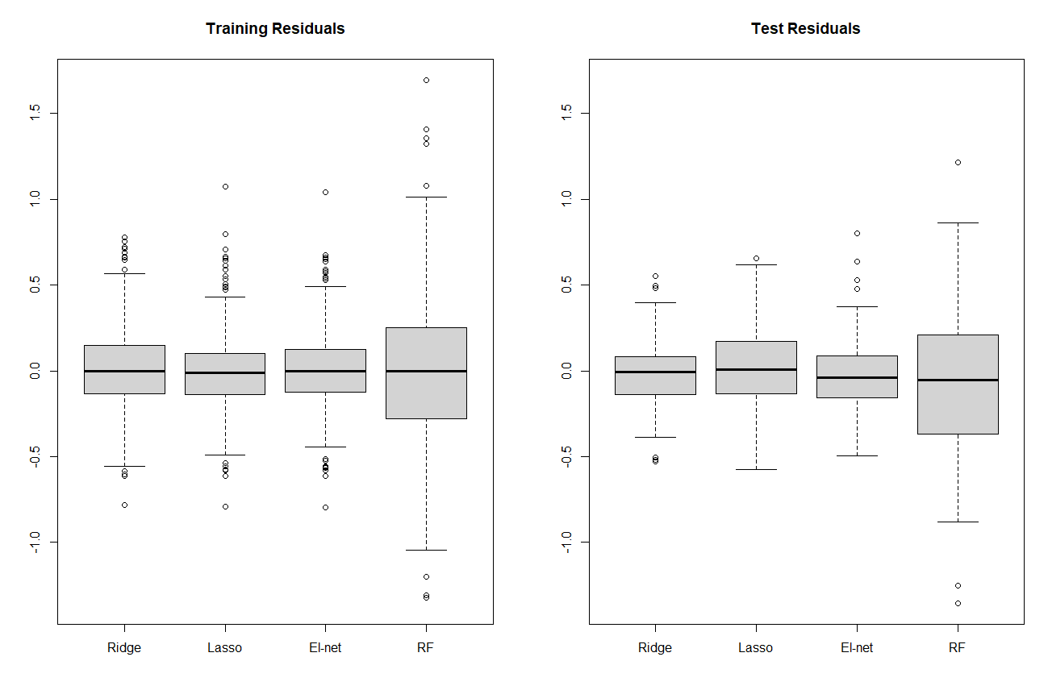
Notes:
Observing the boxplots, we see that they are symmetric about their mean, which is approximately 0, and that the points cluster around the mean. This is evidence that the residuals are normally distributed with mean 0, but further tests such as QQPlots or Wilk’s test for normality would have to be done for greater confirmation. Looking at the training residuals, we see the random forest model has the greatest residual variance amongst all models. Going from training residuals to test residuals, we observe an increase in the range and interquartile range for lasso, suggesting that the test residual variance for lasso is greater than the training residual variance. However the Ridge and El-net methods appear to exhibit the opposite behavior. That is, the sizes of the test boxplots for ridge and elnet are smaller than the corresponding training boxplots, suggesting a decrease in the residual variances for these methods.

Slide 4
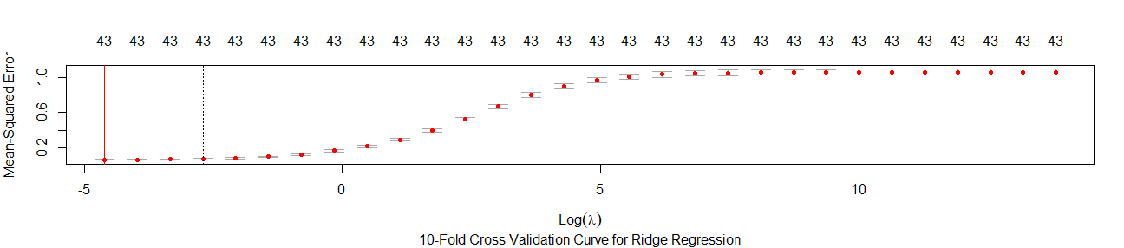
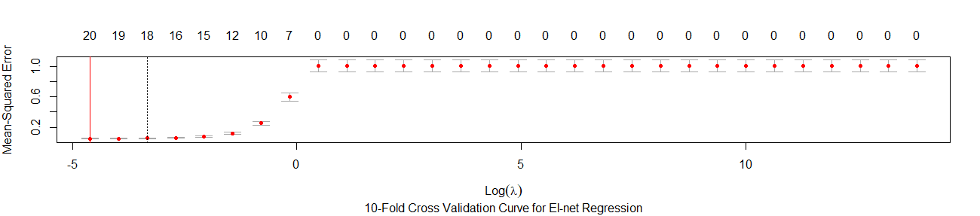
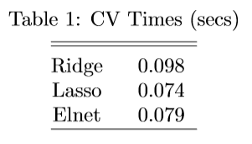
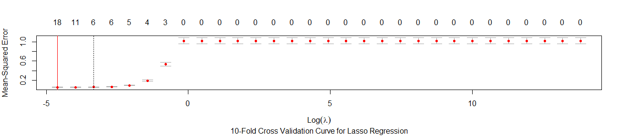
CV Curves
Notes:
Here we can see that the Elastic Net Regression selects for 20 variables and an average runtime of .079 seconds. The Lasso Regression selects for 18 variables and has a runtime of .074 seconds. Ridge doesn’t perform variable selection, so we see all 43 variables present. The runtime is .098 seconds.

Slide 5
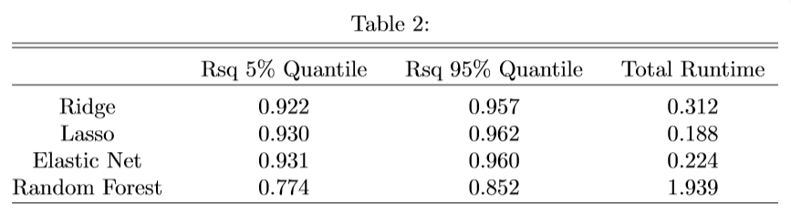
90% Test Intervals and Runtimes
Notes:
Here is a table of the 5th and 95th percentiles for each of the models, along with their average runtimes across the 100 samples. According to the table, We see that the range of R^2’s for the random forest R^2 is completely below the range for the regularization methods. Therefore the regularization methods are clearly preferrable to the random forest, since not only is the worst performing regularization model out of the 100 samples better than the best performing random forest model, but they also run about 10 times faster. Again, this is due to the reasons previously mentioned on the R^2 boxplots.

Slide 6
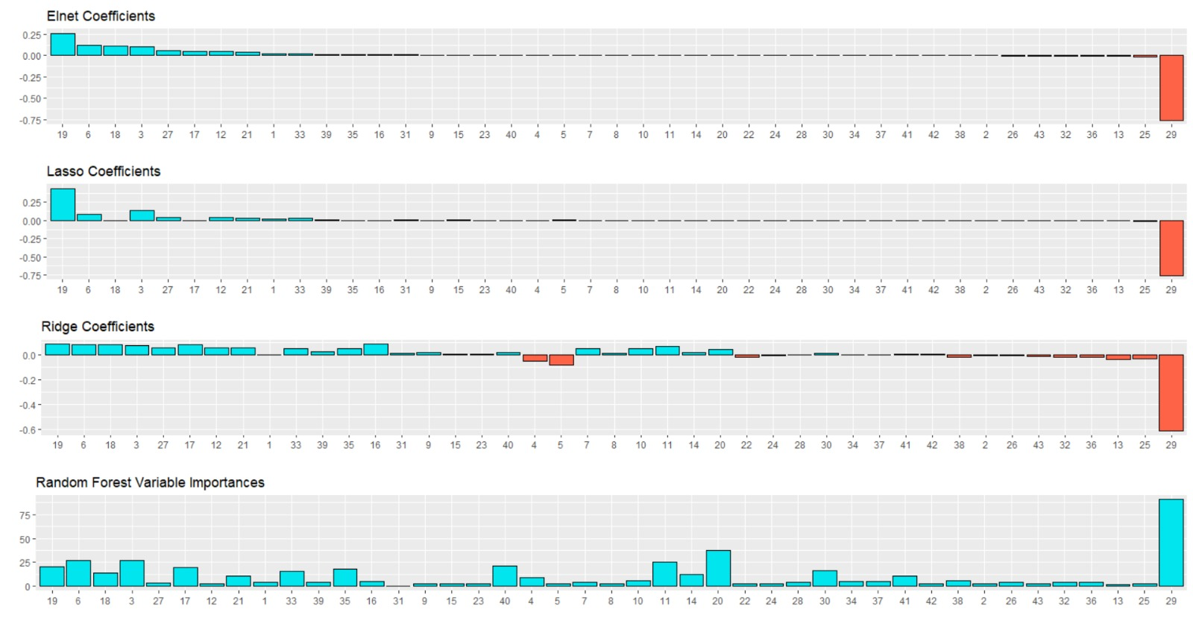

Slide 7
Concluding Remarks
For this data set cross validation is preferable to random forest for the accuracy and time issues previously noted
Maximizing team wins is a combination of minimizing opponents runs and maximizing runs for your team
Further analysis could look into how individual players contribute to each of these factors which have been identified as important for maximizing wins in order to select a team which is more likely to win

